Slide 1

Graduation Project on manufacturing Downtime Analysis
Presentation by
Kareem Ashraf
Mahmoud Walid
Muhamed El-sakka
Muhamed Shokry
Jihad Ismail
April - 2025

Slide 2
Project Agenda
Project Introduction
Project Objectives
Dataset Description
Data Preprocessing & Data Modeling
Exploratory Data Analysis (EDA)
Dashboard & Visualizations
Conclusion & Recommendations

Slide 3

🚀Project Introduction
This project analyzes manufacturing downtime data to identify common downtime causes, measure efficiency, and compare performance across shifts, products, and operators. The goal is to support better decisions and improve production efficiency

Slide 4

🛠️Project Objectives
METHODS USED
REAL-WORLD APPLICATION
The forecasted results help management plan operations more effectively, reduce unexpected downtimes, and improve resource allocation
We employed time-series analysis and machine learning algorithms to analyze trends and generate accurate forecasts

Slide 5

📁Dataset Description
The dataset contains detailed batch-level records from a manufacturing process, focused on downtime and efficiency metrics. It includes over 400 entries, each representing a single production batch.
🧭 Data Scope:
Covers multiple shifts, products, and operators
Includes performance indicators (efficiency, downtime)
Useful for analyzing trends, patterns, and identifying improvement areas

Slide 6

📊Exploratory Data Analysis (EDA)
During the EDA phase, we aimed to answer key analytical questions such as:
•What are the most common downtime factors?
•Which shift experiences the most downtime?
•How does downtime vary by operator?
•What is the average efficiency across all batches?
•What is the average downtime per product?
•What is the contribution of human vs. non-human errors?•What are the most and least efficient batches (Top & Bottom 3)?
•What are the significant downtime factors per product?
•What percentage of batches met the targeted efficiency level?

Slide 7

🔍Data Preparation & Analysis
Using Python
Using SQL
• Cleaned and preprocessed time and downtime data for analysis.
• Calculated production duration and classified shifts by start time.
• Mapped and analyzed downtime factors with human error categorization.
• Calculated multiple efficiency metrics, including those excluding human errors.
• Mapped minimum batch time per product and evaluated operator lagging efficiency.
•Calculated average efficiencies per shift and ranked shifts by total downtime.
•Ranked batches per product based on downtime.
•Compared operator performance across batches using LEAD.
•Summarized downtime and efficiency metrics by product and batch using ROLLUP.

Slide 8
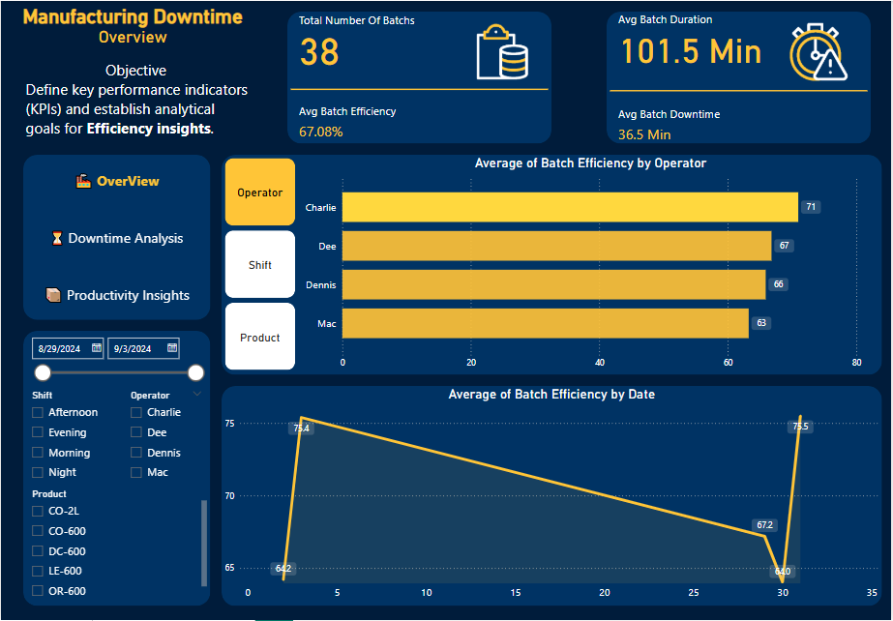
Operational Efficiency Dashboards (page1)
Overview Dashboard
•Analyzed 38 production batches.
•Overall average efficiency: 67.08%, with top operator Charlie achieving 71%.
•Efficiency ranged from 63% to 71% across operators, revealing performance variability.
•Efficiency trend shows a general decline over the month, with a peak day reaching 75%.

Slide 9
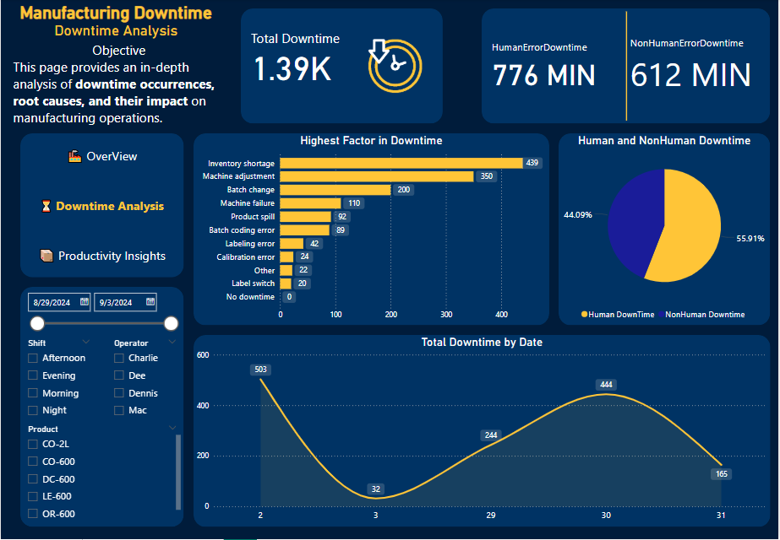
Operational Efficiency Dashboards (page2)
Downtime Analysis Dashboard
•Total recorded downtime: 1,390 minutes.
•55.91% due to human errors (776 minutes), and 44.09% due to non-human factors (612 minutes).
•Top 3 downtime reasons:
•Stock Shortage (439 mins)
•Machine Adjustment (350 mins)
•Batch Changeover (200 mins)
•One specific day experienced 503 minutes of downtime — highlighting a critical event.

Slide 10
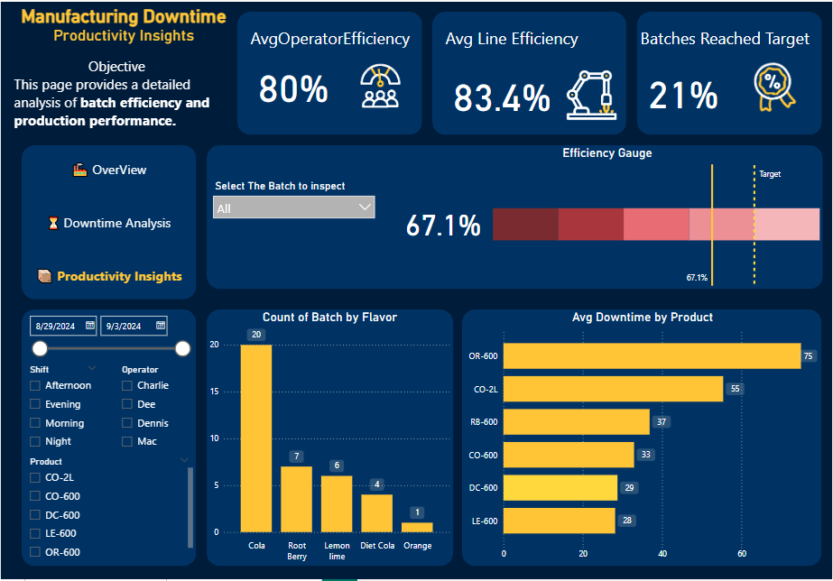
Operational Efficiency Dashboards (page3)
Productivity Insights Dashboard
•Average operator efficiency: 80%, line efficiency: 83.4%, while actual batch efficiency dropped to 67.1% — revealing a performance gap.
•Most produced flavor: Cola (20 batches).
•Product with the highest downtime: CO-600 (494 mins).
•These insights support re-evaluating operator assignments and product distribution to improve efficiency.

Slide 11
Conclusion
Through this project, we successfully identified the main inefficiencies in the production line by analyzing downtime data. We detected key factors behind losses, measured the impact of human and non-human errors, and highlighted gaps in operator and product performance. These insights provide a solid foundation for data-driven decision-making to enhance productivity and minimize downtime.

Slide 12

Graduation Project on Downtime Analysis

